Slide 1

Security is Everybody’s Job
Literally!
Tanya Janca
CEO & Founder
@SheHacksPurple

Slide 2
What are we going to talk about today?
Security is EVERYBODY’S job!
@SheHacksPurple
Notes:
Who here writes code? Put your hands up. Who here supports apps? Who here works in IT? Who here does security? ALL of your hands should be up, because security is EVERYBODY’S JOB. If you write code, it’s your job to write the most secure code you know how to write. If you patch apps, it’s your job to ensure you do security patching.
It is your job to do your job as securely as you can.
It is the security team’s job to *enabled you* to get your job done securely. No matter what job yvou do in IT, part of your job is security.

Slide 3
What are we going to talk about today?
DevOps
@SheHacksPurple
Notes:
Who knows exactly what DevOps is? Well guess what, you’re going to know it inside and out by the end of this talk.

Slide 4
What are we going to talk about today?
Security becoming a part of your everyday work
@SheHacksPurple
Notes:
The old Waterfall security model will not work if the rest of IT is doing DevOps. If they sprint, we sprint. If they automate, we automate. This talk is going to be about what security needs to change so that we can adapt to our developers and ops people doing DevOps. And this means working together, being right in the middle of it. Hence; DevSecOps.

Slide 5
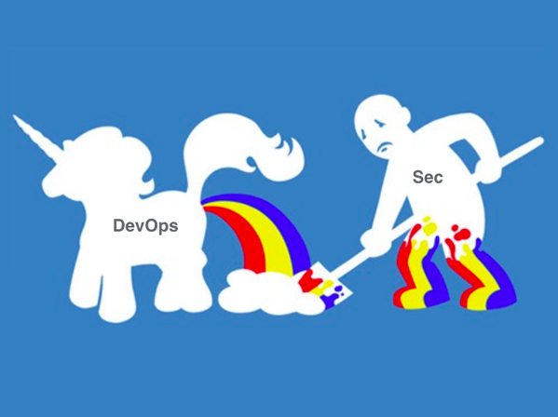
How some security people see DevOps
@SheHacksPurple
Slide Credit: Pete Cheslock
@WeHackPurple
Notes:
Gone are the days when breaches were rare and security could safely be put low on the priority list; product security is now a customer demand and cyber crime has reached epic proportions. Our idolization of hackers, penetration testing and ‘breaking’ has not resulted in secure software for our industry, only egos, stereotypes and unaffordable security models. Modern application security approaches need to address both offensive (red team) and defensive (blue team) approaches, as well as continuous learning and advocacy for developers. This means Purple Team. This talk will explore how to combine defence, offence, automation, empathy and continuous learning, all without the requirement of ever wearing a hoodie. The future of security is PURPLE.

Slide 6
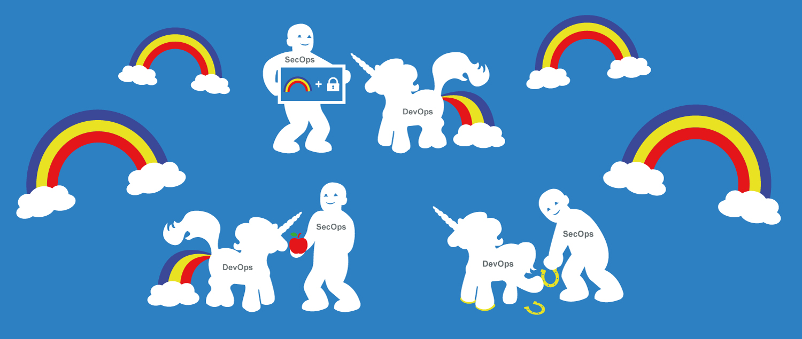
This is how I see DevOps: DevSecOps!
@SheHacksPurple
Slide Credit: DevSecCon
@WeHackPurple
Notes:
Gone are the days when breaches were rare and security could safely be put low on the priority list; product security is now a customer demand and cyber crime has reached epic proportions. Our idolization of hackers, penetration testing and ‘breaking’ has not resulted in secure software for our industry, only egos, stereotypes and unaffordable security models. Modern application security approaches need to address both offensive (red team) and defensive (blue team) approaches, as well as continuous learning and advocacy for developers. This means Purple Team. This talk will explore how to combine defence, offence, automation, empathy and continuous learning, all without the requirement of ever wearing a hoodie. The future of security is PURPLE.

Slide 7

Tanya Janca
About me
CEO & Founder @ We Hack Purple
AKA @SheHacksPurple
Author: Alice and Bob Learn Application Security
20+ years in tech, Sec + Dev
WoSEC (Women of Security) founder
OWASP Chapter and Project founder
Blogger, Podcaster, Streamer, Builder, Breaker
Nerd at Large

Slide 8
Let’s do this!
@SheHacksPurple

Slide 9
Application Security
@SheHacksPurple

Slide 10
What is AppSec?
“It’s any and every activity that you perform to ensure that your software is secure.”
-Tanya Janca
@SheHacksPurple

Slide 11
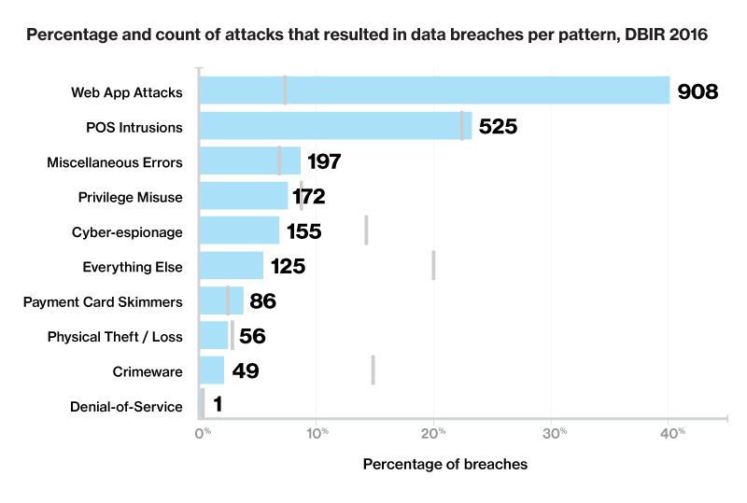
Poor AppSec is a problem!
@SheHacksPurple
Poor AppSec Causes ~29-40% of Breaches!
-Verizon Data Breach Investigation Report (DBIR)
2016, 2017, 2018, 2019
@WeHackPurple
Notes:
Are you spending 40% of your security budget on this? (trust me, you’re not)

Slide 12

Application Security Missing!
AppSec is not covered in most post-secondary Comp-Sci and Soft-Eng programs
And when it is, it’s often an after thought
Photo by Kimberly Farmer on Unsplash
@SheHacksPurple

Slide 13
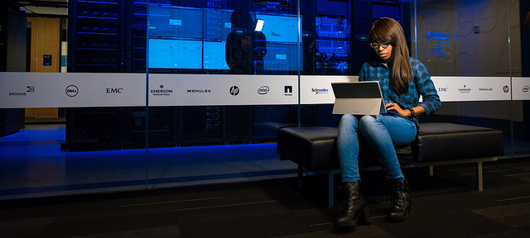
Security is Outnumbered!
Photo: #WOCTechChat
@SheHacksPurple

Slide 14
Security is Outnumbered!
@SheHacksPurple
Dev / Ops / Sec
100 / 10 / 1
@WeHackPurple
Notes:
This is if we are lucky. I’ve had 2000/1, in a traditional waterfall environment. Imagine someone pouring water into a cup, it overflowing, then continuing to poor for 2 years. That’s what that felt like.

Slide 15

Waterfall Never Worked Well
@SheHacksPurple
And the accompanying security model was much, much worse
@WeHackPurple
Photo: Winged Beast

Slide 16
DevSecOps
@SheHacksPurple

Slide 17
What is DevSecOps?
“AppSec in a DevOps environment.”
-Imran A. Mohammed
@SheHacksPurple

Slide 18
The Three Ways of DevOps
Emphasize the efficiency of the entire system.
Fast
Feedback
Continuous Learning
@SheHacksPurple
Notes:
Emphasize the efficiency of the entire system, not just one part.
Fast feedback loops.
Continuous learning, risk taking and experimentation (failing fast), spending time to improve your daily work

Slide 19
Improved Deployment Frequency
@SheHacksPurple
Security emergencies can be fixed NOW
@WeHackPurple
Notes:
DevOps Main Goals:
Improved deployment frequency; Awesome! This means if a security bug is found it can be fixed extremely quickly. <check mark> (tell 8 months for emergency release story)
Shortened lead time between fixes; Fixing all bugs, including security bugs, faster.

Slide 20
Lower Failure Rates
@SheHacksPurple
Resiliency
@WeHackPurple
Notes:
Lower failure rate of new releases and faster recovery time; Meaning better availability, which is a key
security concern with any application (CIA). Explain CIA.
Mean time to recovery
Less requirement for heroics. From security, dev and ops. We all win.

Slide 21
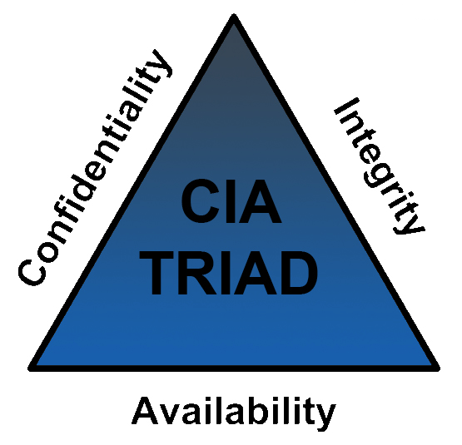
@SheHacksPurple
@WeHackPurple
Notes:
When I show this to developers, almost none of them know what this is. We need to change this. Everyone should know what this is.

Slide 22
Lower Failure Rates
@SheHacksPurple
Confidentiality
Integrity
Availability
=
Resiliency
@WeHackPurple
Notes:
Lower failure rate of new releases and faster recovery time; Meaning better availability, which is a key
security concern with any application (CIA). Explain CIA.
Mean time to recovery
Less requirement for heroics. From security, dev and ops. We all win.

Slide 23
Faster Time to Market
@SheHacksPurple
Security doesn’t win if the business doesn’t also win
@WeHackPurple
Notes:
Read slideDoes security even matter if no one is using the product.
* Faster time to market; meaning the business gets what they want. Sometimes we forget that the entire purpose
of every security team is to enable the business to get the job done securely. And if we are doing DevSecOps,
getting them products that are more secure, faster, is a win for everyone. Again, check mark for security.

Slide 24
DevOps
@SheHacksPurple
The Three Ways
@WeHackPurple
Notes:
Let’s talk more in detail about The 3 ways (and how security fits in perfectly)
Summarize three ways
Emphasize the efficiency of the entire system, not just one part.
Fast feedback loops.
Continuous learning, risk taking and experimentation (failing fast), spending time to improve your daily work

Slide 25
Emphasize the efficiency of the entire system
@SheHacksPurple
Left → Right = Speed
Requirements
Design
Code
Testing
Release
@WeHackPurple
Notes:
1. (left -> right speed) (show SDLC)
Emphasize the efficiency of the entire system, not just one part.
This means that Security CANNOT slow down or stop the entire pipeline (pulling the Andon Cord), unless it's a true emergency.
This means Security learning to sprint, just like Ops and Dev.
Focus on improving ALL value streams, and how securing the final product and network offer value to all other steams.

Slide 26

What does this mean for Security?
Photo: #WOCTechChat
@SheHacksPurple
Notes:
This means that Security CANNOT slow down or stop the entire pipeline (pulling the Andon Cord), unless it's a true emergency.
This means Security learning to sprint, just like Ops and Dev.
Focus on improving ALL value streams, and how securing the final product and network offer value to all other steams.

Slide 27

What does this mean for dev & ops?
Photo: #WOCTechChat
@SheHacksPurple
Notes:
Helping the AppSec team tune static code analysis tools (brakeman, Fortify, checkmarx, etc)
Add the security bugs to the defect tracker, and don’t mark them as “fixed” when the appsec team isn’t looking

Slide 28

What does this mean for dev & ops?
Only deploy up-to-date images and containers.
Photo: #WOCTechChat
@SheHacksPurple
Notes:
Using templates and code samples that are known-secure (sec code library), reused code that has already had security testing performed on them
Using pre-scanned images that are up to date/fully patched
Helping the security team setup automated regular scanning of images and containers

Slide 29
What does this mean for dev & ops?
The “Photo” Slide, #1
Helping the AppSec team tune static code analysis tools
Add security bugs to the defect tracker
Using templates and code samples that a known-secure (sec code library)
Using freshly scanned images that are up to date/fully patched
Setup regular, automated scans for VMs and containers
@SheHacksPurple
Notes:
There will be 4 ”photo” slides, plus the resources at the end. Get your phones ready! ☺

Slide 30

What does this mean for dev & ops?
Help the AppSec Team tune their tools.
For their sake, and yours.
Photo: #WOCTechChat
@SheHacksPurple
Notes:
What does this mean for developers?
Helping AppSec team tune web proxy scanners such as Zap, Burp and SonarCube - addressing issues it finds
If the AppSec team creates a security pipeline for testing for you, use it!
Ensuring your libraries and other 3rd party components are secure by adding OWASP Dependency check or track, Retire.js, Black Duck, Snyk, (more!) to your pipeline.

Slide 31

What does this mean for dev & ops?
Positive testing determines that your application works as expected. If an error is encountered during positive testing, the test fails.
Negative testing ensures that your application can gracefully handle invalid input or unexpected user behavior.
Photo: #WOCTechChat
@SheHacksPurple
Notes:
Add negative use cases as unit tests, not just positive use cases: Morgan Roman

Slide 32
What does this mean for dev & ops?
The “Photo” Slide, #2
Add negative use cases as unit tests, not just positive use cases
Helping AppSec team tune web proxy scanners
If the AppSec team creates a security pipeline for testing for you, use it!
SCA: OWASP Dependency check, Retire.js, Synk, Sonotype, Contrast, White Source, etc. Tools to alert about known vulnerable code/ libraries/ components
@SheHacksPurple

Slide 33
Faster Feedback
@SheHacksPurple
Right → Left = Feedback
= Pushing Left!
Requirements
Design
Code
Testing
Release
@WeHackPurple
Notes:
2. (left <- right - feedback)
Fast feedback loops meanings "Pushing Left" in application security. (house analogy) The goal of security
activities in DevSecOps must be to shorten and amplify feedback loops so security flaws (design issues) and bugs (code issues) are fixed as early as possible, when it's faster, cheaper and easier to do a better job.

Slide 34

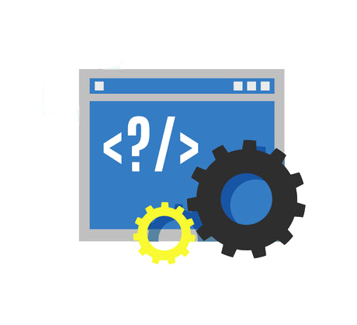
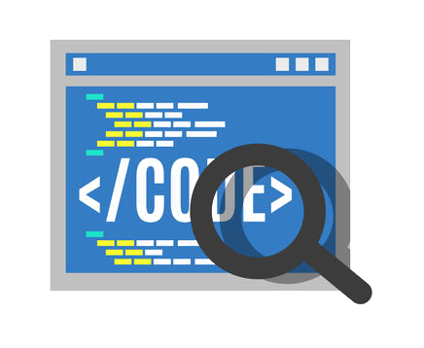
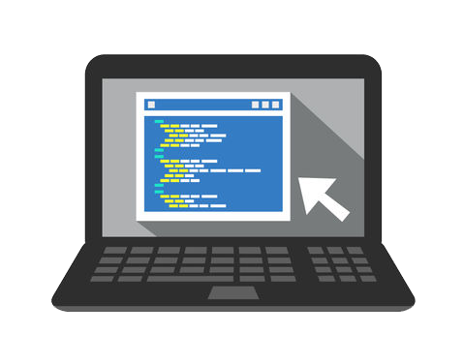
DevOps and the “Shift Left” principle
@SheHacksPurple
Fixing costs of quality & security issues rises significantly as the development cycle advances
CODING
BUILD
PRODUCTION
QA & SECURITY
$80/defect
$240/defect
$960/defect
$7,600/defect
@WeHackPurple
Source: Ponemon Institute Research
Notes:
Assisting in tuning SAST and DAST tools
Reusing known good code
Using up-to-date images
Using the Security Pipeline
Making negative unit tests
Severe security bugs break the build

Slide 35

What does this mean for Security?
Faster Feedback
= Shifting Left
Photo: #WOCTechChat
@SheHacksPurple
Notes:
Fast feedback loops meanings "Pushing Left" in application security. The goal of security
activities in DevSecOps must be to shorten and amplify feedback loops so security flaws (design issues) and bugs (code issues) are fixed as early as possible, when it's faster, cheaper and easier to do a better job.
(house analogy)

Slide 36

What does this mean for dev & ops?
Telling the security team what you are concerned about.
Feedback goes both ways.
Photo: #WOCTechChat
@SheHacksPurple
Notes:
Faster feedback loops (of security related events and activities)
Informing the security team what Dev and Ops are concerned about, so they can ensure they don’t negatively affect those things, feedback
Repo Kid and other permission-reducing activities, for least priv from Netflix. It used to be Repo MAN, but it made the security team unpopular….
if security tests fail, the continuous integration server must break the build. Just like quality tests.

Slide 37

What does this mean for dev & ops?
Participating in Security Activities
Incidents
Threat Modelling
Security Sprints
Etc
Photo: #WOCTechChat
@SheHacksPurple
Notes:
If security tests fail they break the build. Security is a part of quality.
Check all apps for things found in each pentest result, add these tests to unit tests
Performing security sprints
Participating in Threat modelling activities if the AppSec team asks you for help
Participating in security incidents and investigations if need be
Learning to use security tools, and how to use their feedback immediately to improve code quality
Use the security pipeline to test your code

Slide 38
What does this mean for dev & ops?
The “Photo” Slide, #3
Faster feedback loops = fixing bugs sooner
Breaking the build if you introduce security issues
Adding security sprints to your project timeline
Participating in Threat modelling activities
Participating in incident response, if need be
Learning to use security tools
Security becomes part of the definition of quality
@SheHacksPurple
@SheHacksPurple
Notes:
Faster feedback loops (of security problems, that you need to fix)
You will break the build if you introduce security issues
Searching ALL the apps for items found in each pentest result, then add these tests to unit tests
Adding security sprints to your project timeline
Participating in Threat modelling activities
Participating in security incidents and investigations, if need be
If security tests fail, the continuous integration server must break the build. Just like quality tests.
Learning to use security tools, and how to use their feedback immediately to improve code quality
Use the security pipeline to test your code

Slide 39
Continuous Learning
@SheHacksPurple
Full Circle
@WeHackPurple
Notes:
3 (full circle - continuous learning)
•Allocating time for the improvement of daily work
•Creating rituals that reward the team for taking risks

Slide 40

What does this mean for Security?
Photo: #WOCTechChat
@SheHacksPurple
Notes:
3 (full circle - continuous learning)
It means that every moment possible should be a teaching moment.
•Allocating time for the improvement of daily security work FOR DEV AND OPS, enabling both teams to get this done.
•Creating rituals that reward the team for taking risks: celebrate successes
•Introducing faults into the system to increase resilience: red team exercises, Netflix Chaos Monkey

Slide 41

What does this mean for dev & ops?
Photo: #WOCTechChat
@SheHacksPurple
Notes:
3 (full circle - continuous learning)
Accept security training if offered
Train yourself
Share information widely when you fix security issues

Slide 42

What does this mean for dev & ops?
Photo: #WOCTechChat
@SheHacksPurple
Notes:
3 (full circle - continuous learning)
Participate in Security Simulations
Ask for and analyze metrics from security testing results, look for patterns or systemic issues
Ensure you perform blameless introspection

Slide 43
What does this mean for dev & ops?
The “Photo” Slide, #4
Accept security training if offered
Train yourself
Share information widely when you fix security issues
Participate in Security Simulations
Ask for and analyze metrics from security testing, look for patterns or systemic issues
Ensure you perform blameless introspection
@SheHacksPurple
@SheHacksPurple
Notes:
Enabling and encouraging Continual experimentation, risk taking and learning from failure (failing fast):
*pushing to improve security
*innovations in testing, can't be locked down into one process
Fostering the understanding repetition and practice is the prerequisite to mastery:
* Incident simulations: practice makes perfect
* Repeat secure coding training
If the metrics from the AppSec team show there are repetitive issues, create workshops, ensure everyone learns

Slide 44
Security becoming a part of DevOps.
Culture Change
@SheHacksPurple

Slide 45

Reinforce Culture Change
Celebrate security wins.
Photo: #WOCTechChat
@SheHacksPurple
Notes:
Reinforce the new culture that security is everybody’s job
Celebrate when you pass a pentest or pass through the security pipeline for the first time with no highs or mediums (explain High, medium and low)
When you pass a PenTest
Make it through the Sec Pipeline
Handle an incident well
Release Security Fixes

Slide 46

Reinforce Culture Change
Work more closely: Security + Dev + Ops
@SheHacksPurple
Notes:
Have meetings together
Have social events together
Locate your offices close together, if this is an option

Slide 47

Reinforce Culture Change
No more blaming!
Photo: #WOCTechChat
@SheHacksPurple
Notes:
From now on when there’s a problem, don’t blame someone. It’s not Bob or Alice’s error that is the problem, it’s that there weren’t processes or safeguards in place to stop the problem from happening. We don’t care about the who, we only care about how we are going to fix it, and then ensure it will never happen again. This is called a Blameless Post Mortem. It’s okay to fail. But it’s not okay to not learn from it when we do.
If at all possible, always allow someone to “save face”. It will pave the path to a more friendly future.

Slide 48
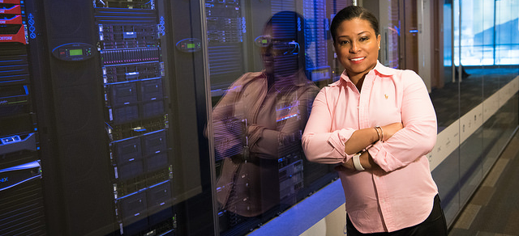
Reinforce Culture Change
Be a Security Champion!
Photo: #WOCTechChat
@SheHacksPurple
Notes:
Create Security Champions. If a developer or ops person is interested in security, foster it. Mentor them, teach them, provide them resources, give them your time. They might become your new teammate someday, if you play your cards right.

Slide 49
Call to Action
We can do it!
Security’s job is to enable Dev and Ops to do their jobs, securely.
Enabling Teaching Automation Feedback
@SheHacksPurple
Notes:
The definition of quality includes “secure” from now on.
Resilience means security.
Learning includes security.
Speed responding to security
Feedback about security.
Raise your right hand and repeat after me: “My job is to enable dev and ops so that we can create secure products, together.”

Slide 50
Resources
@SheHacksPurple

Slide 51
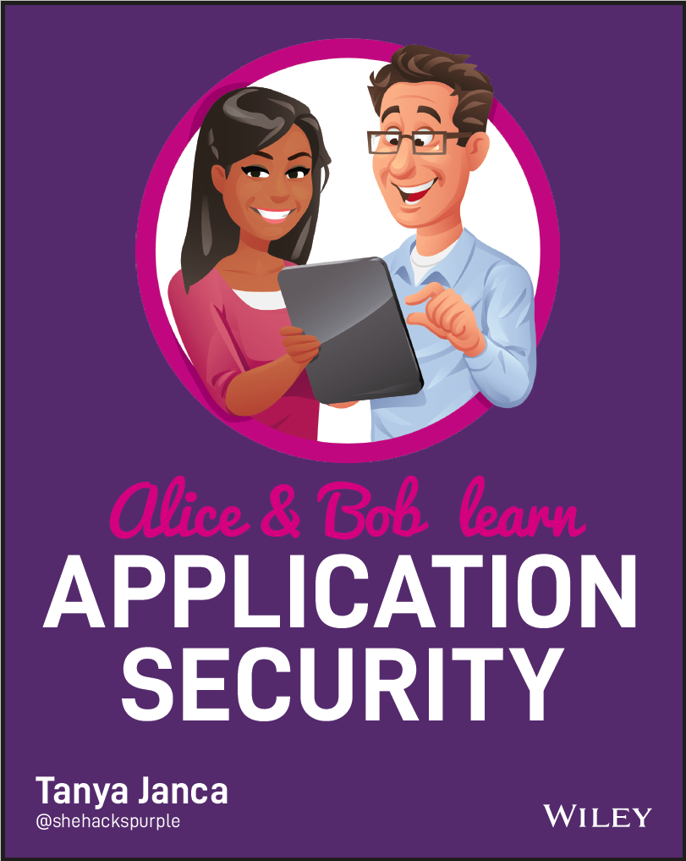

Slide 52
WoSEC – Women of Security
@SheHacksPurple
Women of Security (WoSEC) is a community for women, including LGBTQ+ women, non-binary, trans and gender nonconforming, who have an interest in cyber security.
We want women to join the information security community and have long-term, happy, careers.
https:// WoSEC.tribe.so
https://www.womenofsecurity.com
@WoSECTweets
@WoSECtweets

Slide 53
Join the community!!!!!
Join the We Hack Purple Community for FREE
Community.WeHackPurple.com
Meet like-minded people and nerd out!

Slide 54
#CyberMentoringMonday
@SheHacksPurple
Every Monday!
@WeHackPurple

Slide 55
Resources: ME!
@SheHacksPurple
@SheHacksPurple
AliceAndBobLearn.com
https://wehackpurple.com/blogs
YouTube.com/SheHacksPurple
https://SheHacksPurple.ca
@WeHackPurple

Slide 56
What did we learn today?
Security is now a part of DevOps.
DevSecOps!
@SheHacksPurple
Notes:
Who knows exactly what DevOps is? Well guess what, you’re going to know it inside and out by the end of this talk.

Slide 57
Thank You!
@SheHacksPurple
Tanya Janca
SheHacksPurple.ca
WeHackPurple.com
@WeHackPurple

